Slide 1
RAPID OBJECT DETECTION USING A BOOSTED CASCADE OF SIMPLE FEATURES
Group 10:
Sai Pranav, Venkat, Supreeth, Romaharshan

Slide 2
Paper Overview
Object detection, such as face detection, is a growing field where speed and accuracy are key goals
Approach was the first to achieve real-time face detection
Detector can run at 15 frames per second on on a conventional 700 MHz Intel Pentium III
Detection rates are competitive with some of the best methods to date
A key feature that distinguish this approach from previous ones is that it doesn’t need auxiliary information like pixel color, and image differences in video sequences to achieve high frame rates.
Instead, it does so by working with only a single grey scale image. This auxiliary information can be incorporated to achieve even higher frame rates.
Notes:
https://unsplash.com/photos/F3Y8BfZn4jo
https://unsplash.com/photos/a0EQFTH4ZfA
https://unsplash.com/photos/mEZ3PoFGs_k
https://unsplash.com/photos/DItYlc26zVI

Slide 3
Introduction
Viola-Jones Detector
Haar-like Features - simple rectangular features
Calculating the Integral Image summed area table necessary for quick calculation
AdaBoost Learning Algorithm - creates a small set of only the best features to create more efficient classifiers
Cascade Filter - discards negative windows early to focus more computational time on possible positive windows
Notes:
https://unsplash.com/photos/F3Y8BfZn4jo
https://unsplash.com/photos/a0EQFTH4ZfA
https://unsplash.com/photos/mEZ3PoFGs_k
https://unsplash.com/photos/DItYlc26zVI

Slide 4
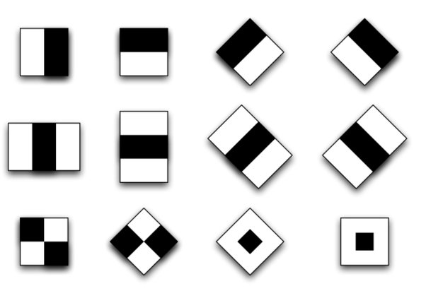
Haar-like Features
Simple features that provide just above random accuracy
Each feature is a difference calculation of the white area minus the dark area
Numerous Haar-like features available to choose from as shown here
Notes:
https://unsplash.com/photos/F3Y8BfZn4jo
https://unsplash.com/photos/a0EQFTH4ZfA
https://unsplash.com/photos/mEZ3PoFGs_k
https://unsplash.com/photos/DItYlc26zVI

Slide 5
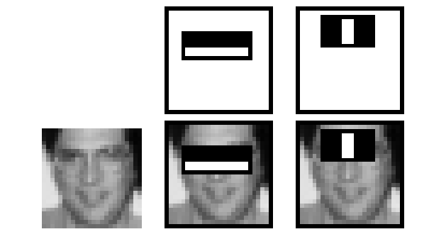
Haar-like Features
The two features are shown in the top row and then overlayed on a typical training face in the bottom row.
The first feature measures the difference in intensity between the region of the eyes and a region across the upper cheeks.
The feature capitalizes on the observation that the eye region is often darker than the cheeks.
The second feature compares the intensities in the eye regions to the intensity across the bridge of the nose.
Notes:
https://unsplash.com/photos/F3Y8BfZn4jo
https://unsplash.com/photos/a0EQFTH4ZfA
https://unsplash.com/photos/mEZ3PoFGs_k
https://unsplash.com/photos/DItYlc26zVI

Slide 6
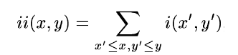
Integral Image
Summed area table in which every block is the summation of the previous blocks
Point of origin is upper left corner, meaning previous blocks are defined as those above and to the left
Notes:
https://unsplash.com/photos/F3Y8BfZn4jo
https://unsplash.com/photos/a0EQFTH4ZfA
https://unsplash.com/photos/mEZ3PoFGs_k
https://unsplash.com/photos/DItYlc26zVI

Slide 7
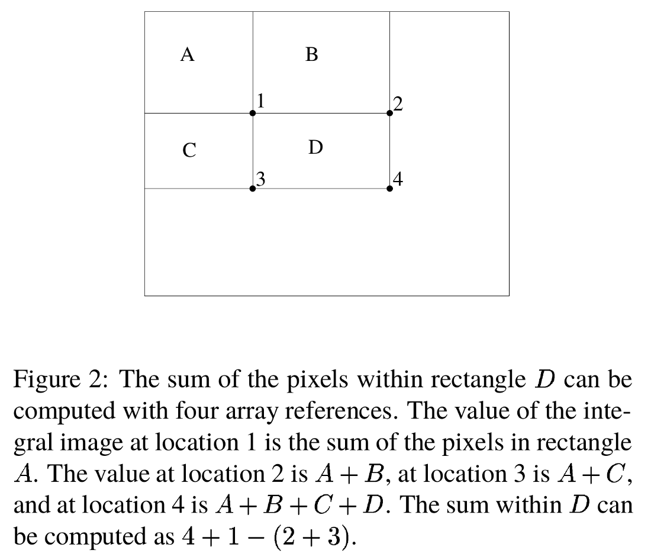
Integral Image (Calculation)
Allows for quick computations of any area in an image
Sum of pixels in rectangle D only 4 memory lookups
Value of Integral Image at 1 is A
Value of Integral Image at 2 is A+B
Value of Integral Image at 3 is A+C
Value of Integral Image at 4 is A+B+C+D
Sum of pixels in D = 4-2-3+1
Notes:
https://unsplash.com/photos/F3Y8BfZn4jo
https://unsplash.com/photos/a0EQFTH4ZfA
https://unsplash.com/photos/mEZ3PoFGs_k
https://unsplash.com/photos/DItYlc26zVI

Slide 8
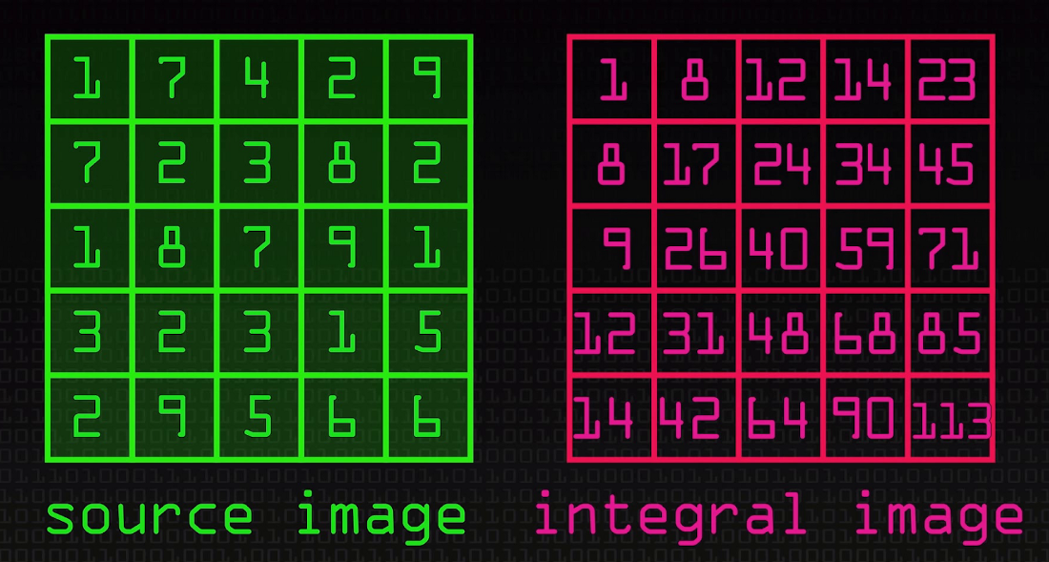
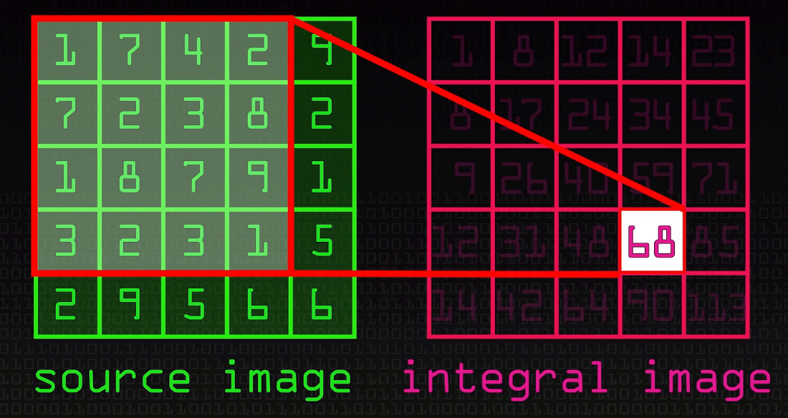
Integral Image (Calculation)
Notes:
https://unsplash.com/photos/F3Y8BfZn4jo
https://unsplash.com/photos/a0EQFTH4ZfA
https://unsplash.com/photos/mEZ3PoFGs_k
https://unsplash.com/photos/DItYlc26zVI

Slide 9
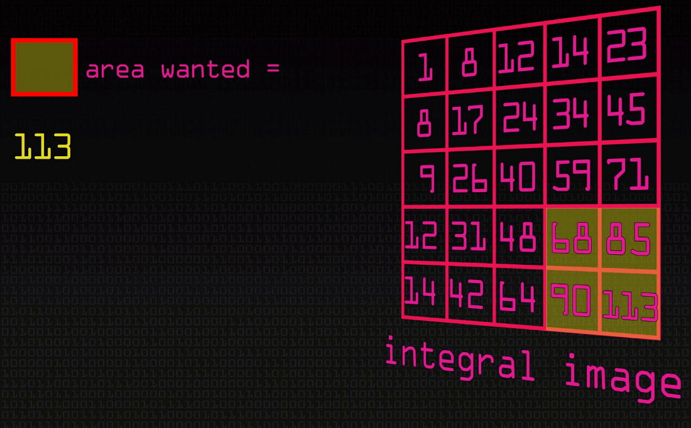
Integral Image (Usage)
Notes:
https://unsplash.com/photos/F3Y8BfZn4jo
https://unsplash.com/photos/a0EQFTH4ZfA
https://unsplash.com/photos/mEZ3PoFGs_k
https://unsplash.com/photos/DItYlc26zVI

Slide 10
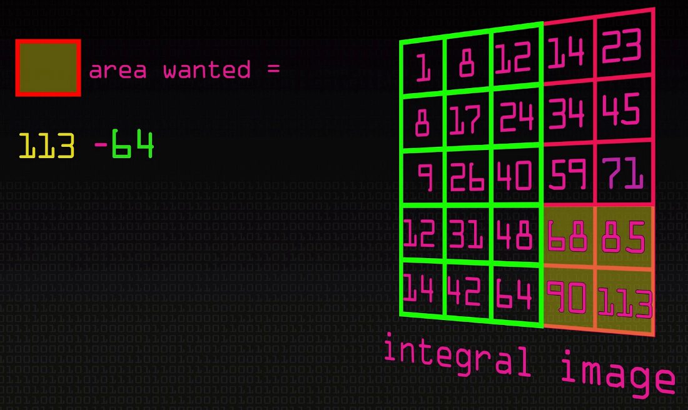
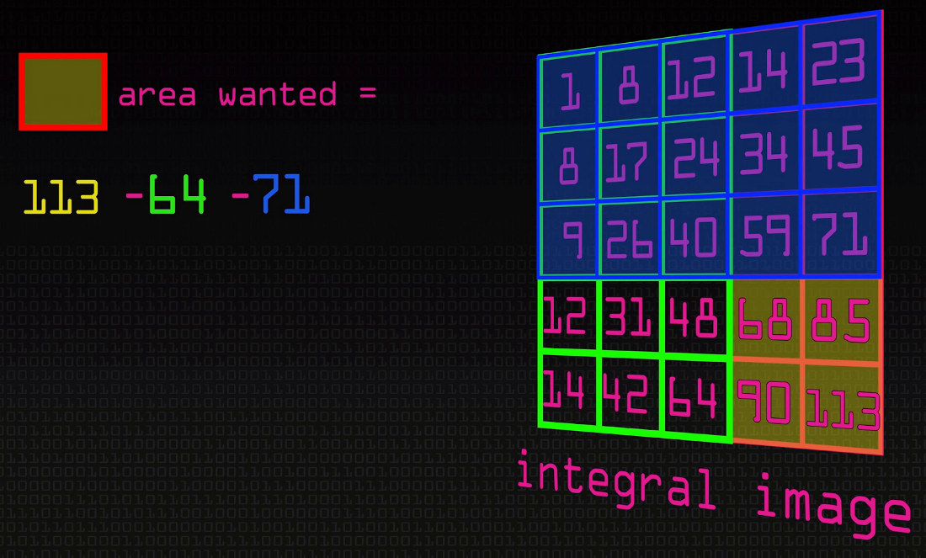
Integral Image (Usage)
Notes:
https://unsplash.com/photos/F3Y8BfZn4jo
https://unsplash.com/photos/a0EQFTH4ZfA
https://unsplash.com/photos/mEZ3PoFGs_k
https://unsplash.com/photos/DItYlc26zVI

Slide 11
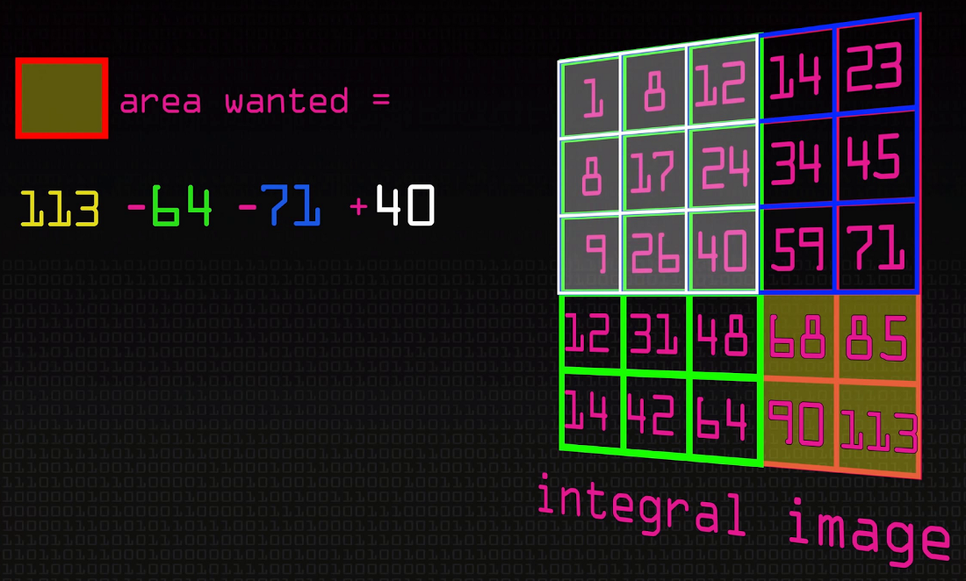
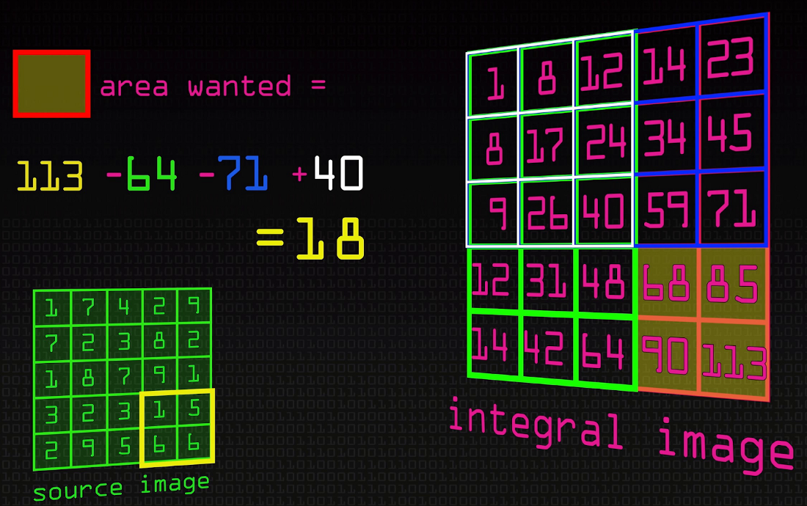
Integral Image (Usage)
Notes:
https://unsplash.com/photos/F3Y8BfZn4jo
https://unsplash.com/photos/a0EQFTH4ZfA
https://unsplash.com/photos/mEZ3PoFGs_k
https://unsplash.com/photos/DItYlc26zVI

Slide 12
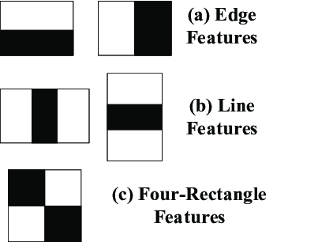
Feature Implementation
Chose a subset of 5 more basic features.
Constant time evaluation using integral image
Edge Features - 6 memory lookups
Line Features - 8 memory lookups
Four-rectangle Features - 9 memory lookups
Programmed with adjustable height and width dimensions for scaling
Notes:
https://unsplash.com/photos/F3Y8BfZn4jo
https://unsplash.com/photos/a0EQFTH4ZfA
https://unsplash.com/photos/mEZ3PoFGs_k
https://unsplash.com/photos/DItYlc26zVI

Slide 13
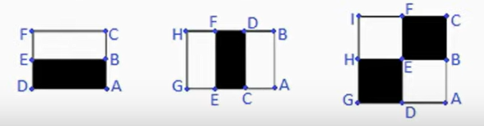
Feature Calculations
Using the integral image:
2Rectangle = A - 2B + C - D +2E – F
3Rectangle = A - B - 2C + 2D + 2E - 2F - G + H
4Rectangle = A - 2B + C - 2D + 4E - 2F + H - 21 + J
Notes:
https://unsplash.com/photos/F3Y8BfZn4jo
https://unsplash.com/photos/a0EQFTH4ZfA
https://unsplash.com/photos/mEZ3PoFGs_k
https://unsplash.com/photos/DItYlc26zVI

Slide 14
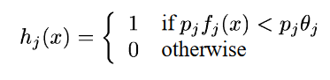
Adaboost Learning Algorithm
Learning algorithm used to train the classifier and select the best subset of features
Aggressive approach that will disregard the majority of features
The weak learning algorithm is designed to select the single rectangle feature which best separates the positive and negative examples.
Each weak classifier h_{j} consists of:
Feature f_{j}
Threshold Θ_{j}
Polarity p_{j}
Notes:
https://unsplash.com/photos/F3Y8BfZn4jo
https://unsplash.com/photos/a0EQFTH4ZfA
https://unsplash.com/photos/mEZ3PoFGs_k
https://unsplash.com/photos/DItYlc26zVI

Slide 15
Training Implementation
Training the weak classifiers is the most computationally expensive piece of the algorithm because each time a new weak classifier is selected as the best one, all of them have to be retrained since the training examples are weighted differently.
There is an efficient way to find the optimal threshold and polarity for a single weak classifier using the weights.
First, sort the weights according to the feature value that they correspond to.
Now iterate through the array of weights and compute the error if the threshold was chosen to be that feature.
Find the threshold and polarity with the minimum error. The possible values for a threshold are the values of the feature on each training example.
Notes:
https://unsplash.com/photos/F3Y8BfZn4jo
https://unsplash.com/photos/a0EQFTH4ZfA
https://unsplash.com/photos/mEZ3PoFGs_k
https://unsplash.com/photos/DItYlc26zVI

Slide 16
Training Implementation
T represents a total sum of weights and S represents the sum of the weights of all examples seen so far.
The superscripts “+” and “-” signify which class the sum pertains to.
Conceptually, this error compares how many examples will be misclassified if all examples below the current location are labeled as negative with how many examples will be misclassified if all examples below the current location are labeled as positive (taking into account how each example is weighted).
Notes:
https://unsplash.com/photos/F3Y8BfZn4jo
https://unsplash.com/photos/a0EQFTH4ZfA
https://unsplash.com/photos/mEZ3PoFGs_k
https://unsplash.com/photos/DItYlc26zVI

Slide 17
Training Implementation
The threshold is set to the value of the feature at which the error is a minimum.
The polarity is determined by how many positive examples and negative examples lie left (less than) and right of the threshold (greater than).
If there are more positive examples left of the threshold, p=1. Otherwise, p = -1.
Once we have trained all the weak classifiers, we can now find the best one.
That is as simple as iterating through all the classifiers and calculating the average weighted error of each one.
Notes:
https://unsplash.com/photos/F3Y8BfZn4jo
https://unsplash.com/photos/a0EQFTH4ZfA
https://unsplash.com/photos/mEZ3PoFGs_k
https://unsplash.com/photos/DItYlc26zVI

Slide 18
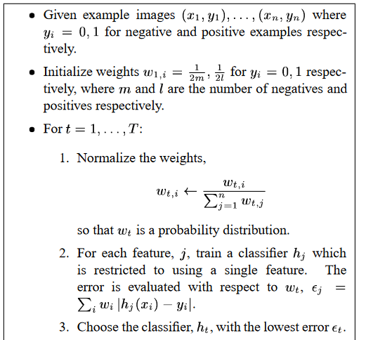
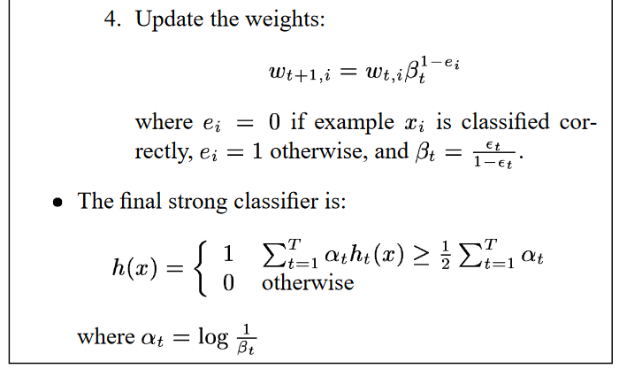

Training Implementation (Ada Boost)
Notes:
https://unsplash.com/photos/F3Y8BfZn4jo
https://unsplash.com/photos/a0EQFTH4ZfA
https://unsplash.com/photos/mEZ3PoFGs_k
https://unsplash.com/photos/DItYlc26zVI

Slide 19
Training Implementation (Ada Boost)
Before choosing the best classifier, we should normalize the weights.
After choosing the best weak classifier, we must update the weights with the error of the chosen weak classifier.
Training examples which were classified correctly will get smaller weights, examples which are classified incorrectly will have their weights stay the same.
Epsilon represents the error of the best classifier, w is the weight of the ith example, and beta is the factor why which to change the weight.
The exponent of beta is 1-e where the e is 0 if the training example was classified correctly and 1 if classified incorrectly
Notes:
https://unsplash.com/photos/F3Y8BfZn4jo
https://unsplash.com/photos/a0EQFTH4ZfA
https://unsplash.com/photos/mEZ3PoFGs_k
https://unsplash.com/photos/DItYlc26zVI

Slide 20
Training Implementation (Ada Boost)
Finally, we have to compile the strong classifier out of our weak classifiers.
The coefficient alpha is how much weight each weak classifier has in the final decision, and it is dependent on the error since it is the natural log of the inverse of beta.
The weighted sum of the weak classifiers’ decisions is compared to half the sum of the alphas because it is like saying “At least half the weak classifiers agree with a positive classification.”
Notes:
https://unsplash.com/photos/F3Y8BfZn4jo
https://unsplash.com/photos/a0EQFTH4ZfA
https://unsplash.com/photos/mEZ3PoFGs_k
https://unsplash.com/photos/DItYlc26zVI

Slide 21
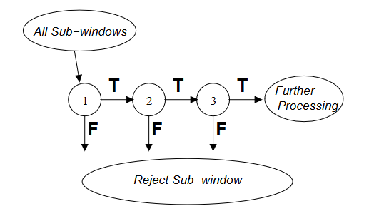
Cascade Filter
The attentional cascade uses a series of Viola-Jones strong classifiers, each progressively more complex, to classify an image.
Strong features are formed into a binary tree
Positive matches are sent along to the next feature
Negative matches are rejected and exit evaluations
Notes:
https://unsplash.com/photos/F3Y8BfZn4jo
https://unsplash.com/photos/a0EQFTH4ZfA
https://unsplash.com/photos/mEZ3PoFGs_k
https://unsplash.com/photos/DItYlc26zVI

Slide 22
Cascade Filter (Training)
The first classifier trains on all training examples, each subsequent classifier is trained on all the positive examples and only the negative examples which the previous classifier misclassified (the false positives).
Thus, each classifier in the cascade focuses on “more difficult” features.
The eventual outcome of introducing the cascade is that the false positive rate (how many non-faces are classified as faces) is dramatically reduced.
Notes:
https://unsplash.com/photos/F3Y8BfZn4jo
https://unsplash.com/photos/a0EQFTH4ZfA
https://unsplash.com/photos/mEZ3PoFGs_k
https://unsplash.com/photos/DItYlc26zVI

Slide 23
Data Set
The data is described at http://cbcl.mit.edu/software-datasets/FaceData2.html, and we downloaded it from www.ai.mit.edu/courses/6.899/lectures/faces.tar.gz and compiled into pickle files.
Each image is 19x19 and greyscale.
Training Data(training.pkl): 2429 face images, 4548 non-face images.
Testing Data(test.pkl): 472 faces, 23573 non-face images.

Slide 24
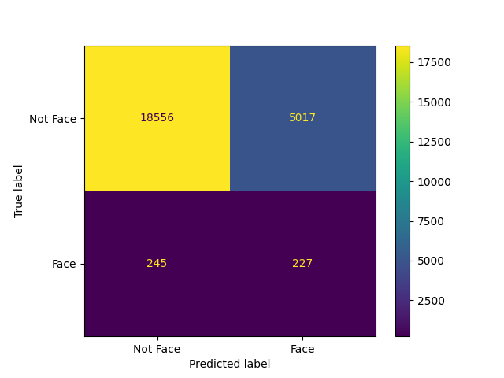
Results
For 10.pkl(A strong classifier with 10 features)
False Positive Rate: 5017/23573 (0.212828)
False Negative Rate: 245/472 (0.519068)
Accuracy: 18783/24045 (0.781160)
Average Classification Time: 0.000617
Notes:
https://unsplash.com/photos/F3Y8BfZn4jo
https://unsplash.com/photos/a0EQFTH4ZfA
https://unsplash.com/photos/mEZ3PoFGs_k
https://unsplash.com/photos/DItYlc26zVI

Slide 25
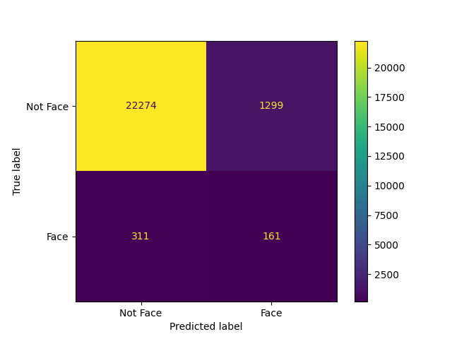
Results
For 50.pkl (A strong classifier with 50 features)
False Positive Rate: 1299/23573 (0.055105)
False Negative Rate: 311/472 (0.658898)
Accuracy: 22435/24045 (0.933042)
Average Classification Time: 0.000747
Notes:
https://unsplash.com/photos/F3Y8BfZn4jo
https://unsplash.com/photos/a0EQFTH4ZfA
https://unsplash.com/photos/mEZ3PoFGs_k
https://unsplash.com/photos/DItYlc26zVI

Slide 26
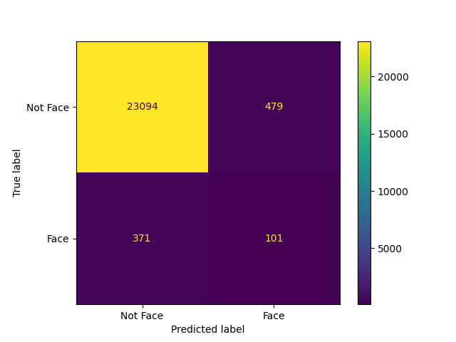
Results
For 200.pkl (A strong classifier with 200 features)
False Positive Rate: 479/23573 (0.020320)
False Negative Rate: 371/472 (0.786017)
Accuracy: 23195/24045 (0.964650)
Average Classification Time: 0.001135
"Initial experiments demonstrated that a frontal face classifier constructed from 200 features yields an accuracy of 96%" - from the paper
Notes:
https://unsplash.com/photos/F3Y8BfZn4jo
https://unsplash.com/photos/a0EQFTH4ZfA
https://unsplash.com/photos/mEZ3PoFGs_k
https://unsplash.com/photos/DItYlc26zVI

Slide 27
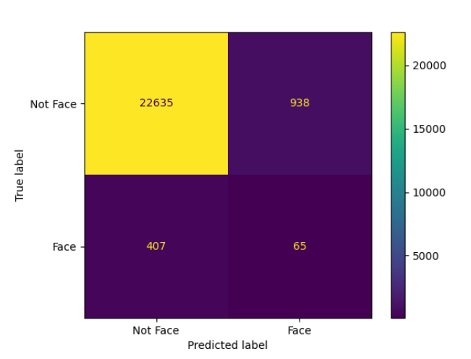
Results
For cascade1.pkl (1,2,3 feature classifiers)
False Positive Rate: 938/23573 (0.039791)
False Negative Rate: 407/472 (0.862288)
Accuracy: 22700/24045 (0.944063)
Average Classification Time: 0.000837
Notes:
https://unsplash.com/photos/F3Y8BfZn4jo
https://unsplash.com/photos/a0EQFTH4ZfA
https://unsplash.com/photos/mEZ3PoFGs_k
https://unsplash.com/photos/DItYlc26zVI

Slide 28
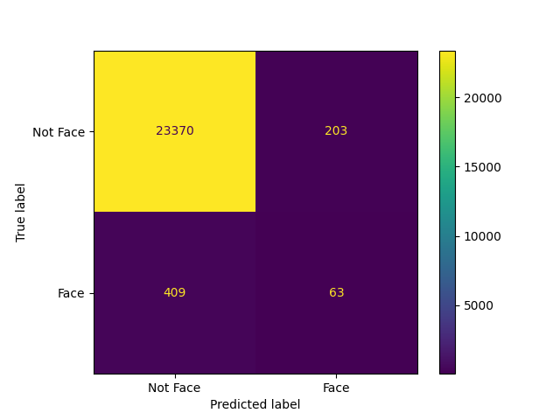
Results
For cascade2.pkl (1,10,50,100 feature classifiers)
False Positive Rate: 203/23573 (0.008612)
False Negative Rate: 409/472 (0.866525)
Accuracy: 23433/24045 (0.974548)
Average Classification Time: 0.000777
Notes:
https://unsplash.com/photos/F3Y8BfZn4jo
https://unsplash.com/photos/a0EQFTH4ZfA
https://unsplash.com/photos/mEZ3PoFGs_k
https://unsplash.com/photos/DItYlc26zVI

Slide 29
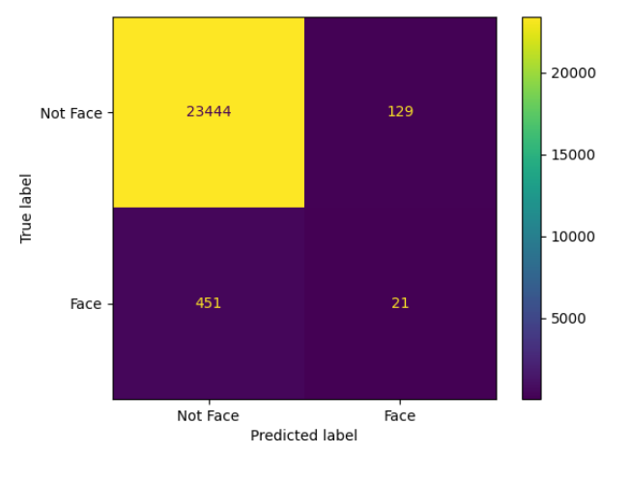
Results
For cascade.pkl (1,2,5,10,50 feature classifiers)
False Positive Rate: 129/23573 (0.005472)
False Negative Rate: 451/472 (0.955508)
Accuracy: 23465/24045 (0.975879)
Average Classification Time: 0.000355
Notes:
https://unsplash.com/photos/F3Y8BfZn4jo
https://unsplash.com/photos/a0EQFTH4ZfA
https://unsplash.com/photos/mEZ3PoFGs_k
https://unsplash.com/photos/DItYlc26zVI

Slide 30
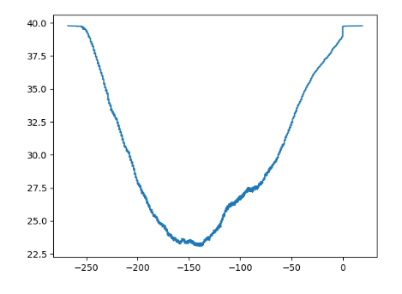
Threshold vs Errors(200 features):
Notes:
https://unsplash.com/photos/F3Y8BfZn4jo
https://unsplash.com/photos/a0EQFTH4ZfA
https://unsplash.com/photos/mEZ3PoFGs_k
https://unsplash.com/photos/DItYlc26zVI

Slide 31
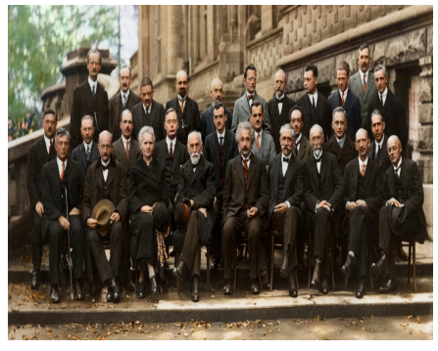
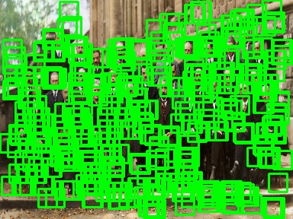
Face Detection (Cascade1.pkl):

Slide 32
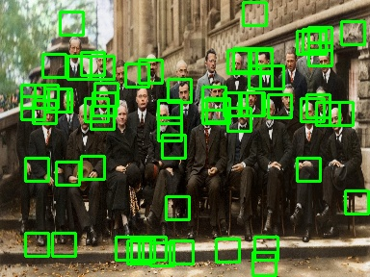
Face Detection (Cascade2.pkl):

Slide 33
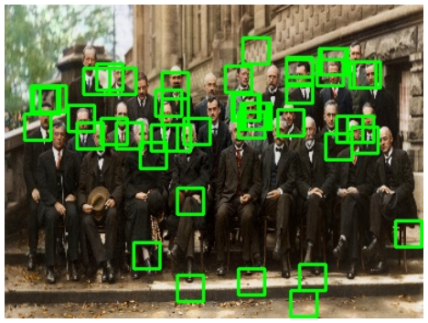
Face Detection (Cascade.pkl):

Slide 34
Work Disribution
Chunduru Sai Pranav: AdaBoost Implementation, Cascade Classifier, Documentation
Supreeth Reddy Gangam: AdaBoost Implementation, Cascade Classifier, Results
Pusapati Romaharshan: ViolaJones Algorithm( haar-like and integral image), Weak Classifier Implementation, Results
Pothugunta Venkat: ViolaJones Algorithm( haar-like and integral image), Weak Classifier Implementation, Documentation

Slide 35
THANK YOU

